Slide 1
Car Parking System
Group Members
Abdul Rafay 190901
M.Amjad 190913

Slide 2
Header Files Used
#include<iostream>
If you need to add streams you need to include it. It is used to for input and output services.
#include<string>
It is used to add characters present on the key board.

Slide 3
Datatypes Used
Int Type
Int type is used to take integer numbers.
Char Type
Char type is used to take characters on keyboards in a given range
String Type
String type is used take characters on keyboard

Slide 4
Working
In this Car Parking System First of all System will ask the user about his information.First system will ask about the user name,his father name,his CNIC number and the type of vehicle and for how much time he wants to park his vehicle.Then system will give the price details of Each type of Vehicle in order.Then system will ask the user to choose his option from above given order.After choosing option system will tell the total price and give the user receipt in which above given details will be mentioned

Slide 5
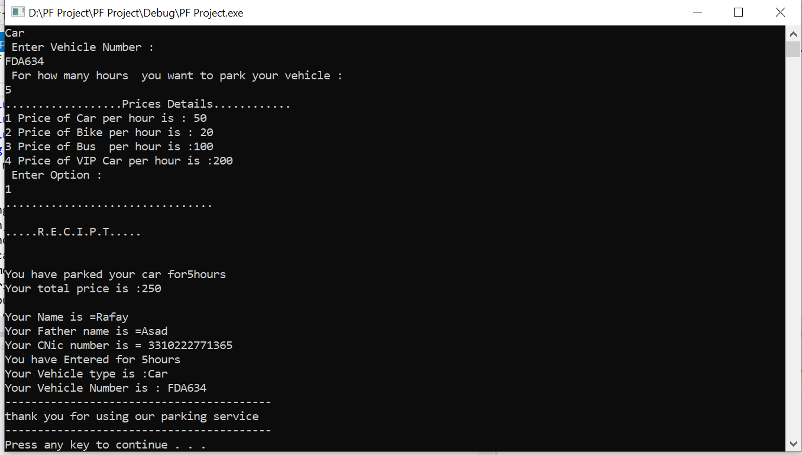
Screenshot

